Slide 1
Enhancing Video Communication through Socket Programming: A UDP Datagram-Based Video Calling System
Vinayak Joshi
Kaushal Singh
Kushagra Saraf
Kush Agarwal

Slide 2
Objectives And Importance
Objective
Explore socket programming's role in video communication.
Present the concept and advantages of UDP-based video calling.
Explain the system architecture and implementation.
Address performance, scalability, and security aspects.
Showcase real-world applications and case studies.
Importance
Enables real-time, low-latency communication.
Provides scalability and cost-efficiency.
Offers customization and security enhancements.
Equips organizations for future communication needs and competitive advantage.

Slide 3
UDP-Based Video Calling
Concept and Advantages of UDP-Based Video Calling:
UDP (User Datagram Protocol): Low latency, real-time communication, efficient data transmission.
System Architecture: Data segmented into packets, codec usage for compression.
Performance: Minimal delay, no connection setup overhead.
Scalability: Handles a large number of connections.
Security: End-to-end encryption and secure authentication for privacy

Slide 4
Advantages of UDP-Based Video Calling:
Real-world Applications and Case Studies:
Zoom, Skype for video conferencing.
Online gaming for multiplayer interactions.
Telemedicine for remote consultations.
Case studies showcase effectiveness in various industries.

Slide 5
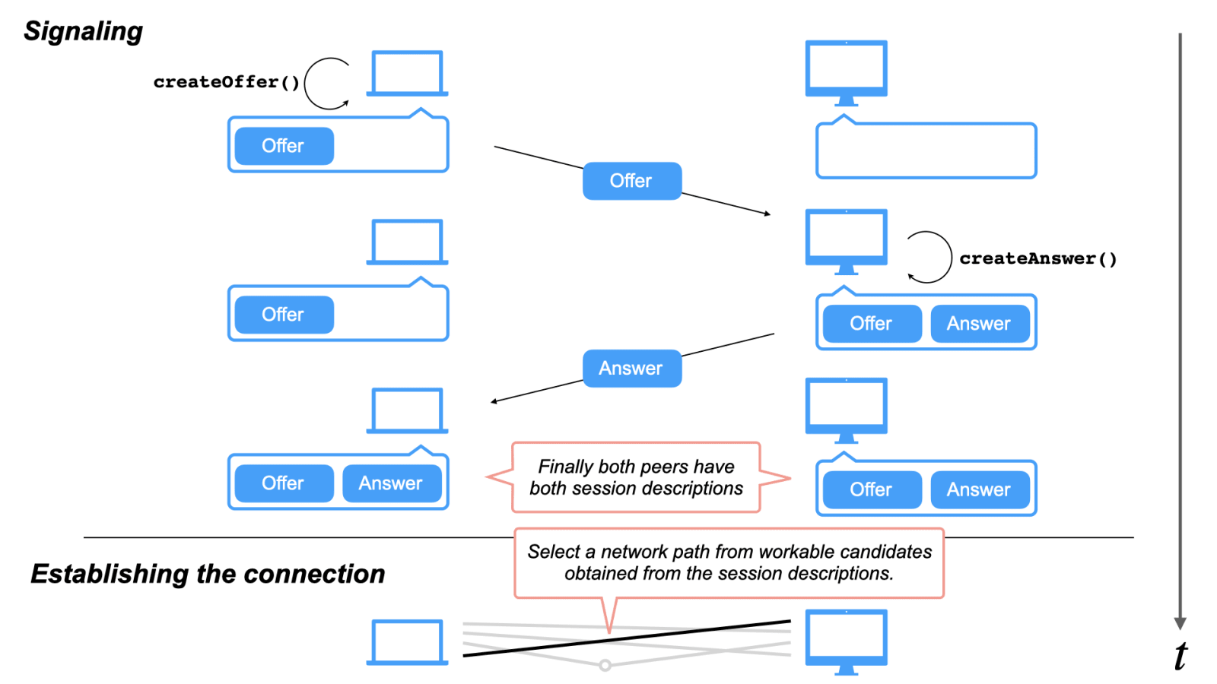

Slide 6
Code Walkthrough: Client
def sendImage():
os.system('python server.py')
t1 = threading.Thread(target=sendImage)
t1.start()
client_socket = socket.socket(socket.AF_INET, socket.SOCK_STREAM)
host_ip = '192.168.29.32'
port = 9966
client_socket.connect((host_ip, port))
data = b""
payload_size = struct.calcsize("Q")
while True:
while len(data) < payload_size:
packet = client_socket.recv(8 * 1024)
if not packet: break
data += packet
packed_msg_size = data[:payload_size]
data = data[payload_size:]
msg_size = struct.unpack("Q", packed_msg_size)[0]
while len(data) < msg_size:
data += client_socket.recv(8 * 1024)
frame_data = data[:msg_size]
data = data[msg_size:]
frame = pickle.loads(frame_data)
cv2.imshow("Live Streaming Video Chat", frame)
key = cv2.waitKey(1) & 0xFF
if key == ord('q'):
break
client_socket.close()
\

Slide 7
Explanation
This code snippet represents a Python-based real-time video chat application using sockets and OpenCV.
It starts by creating a thread ‘t1’’ that runs the ‘send Image’ function.
The code enters a loop to continuously receive and display video frames.
The code receives data packets in chunks and reconstructs them to form video frames.
It uses OpenCV (“cv2”) to display the receive video frames in a window labelled “Live Streaming Video Chat”.
The video window will stay open until the user presses the 'q' key. Upon pressing 'q,' the application closes and releases resources.

Slide 8
Code Walkthrough: Server
server_socket = socket.socket(socket.AF_INET, socket.SOCK_STREAM)
host_ip = '192.168.29.79'
print('[+] Connecting to : ', host_ip)
port = 9966
socket_address = (host_ip, port)
server_socket.bind(socket_address)
server_socket.listen(5)
print("[*] Listening as : ", socket_address)
while True:
client_socket, addr = server_socket.accept()
print('[+] Connected:', addr)
if client_socket:
vid = cv2.VideoCapture(0)
vid.set(cv2.CAP_PROP_FRAME_WIDTH, 640)
vid.set(cv2.CAP_PROP_FRAME_HEIGHT, 500)
while (vid.isOpened()):
img, frame = vid.read()
a = pickle.dumps(frame)
message = struct.pack("Q", len(a)) + a
client_socket.sendall(message)
cv2.imshow("Sender's Video", frame)
key = cv2.waitKey(1) & 0xFF
if key == ord('q'):
client_socket.close()

Slide 9
Explanation
The code begins by creating a server socket that listens for incoming connections on a specified IP address.
When a client connects, the server accepts the connection and initializes video capture using OpenCV.
The video stream from the local camera is captured and serialized using the ‘pickle’ module.
Each frame is packaged with its size and sent to the connected client using binary ‘struct’ message.
The client can display the received video frames in real-time. The server continuously captures and sends video frames until the user presses the 'q' key, at which point it closes the connection.

Slide 10
OpenCV (‘cv2’)
OpenCV, which stands for Open Source Computer Vision Library, is an open-source computer vision and machine learning software library. It provides a vast array of tools and functions for image and video processing, including object detection, image manipulation, facial recognition, and more. OpenCV is widely used in various applications, such as computer vision research, robotics, medical imaging, and real-time image and video analysis. In the code you provided, cv2.VideoCapture() is used to capture video frames from a camera, and cv2.imshow() is used to display these frames in a window.

Slide 11
‘pickle’ module
The pickle module serves a crucial function by facilitating the serialization and deserialization of Python objects, primarily video frames, as they are transmitted between the client and server. When exchanging video frames in a real-time communication application like video calling, these frames often take the form of complex data structures that require conversion into a byte stream to be effectively transmitted via UDP. Serialization, the process of converting these Python objects into a sequence of bytes, is imperative because UDP packets can only convey data in byte format. To achieve this, the pickle module is utilized to serialize a video frame, effectively converting it into a series of bytes that encapsulate both the frame's data and structure.
Upon receiving the serialized frame via UDP, the deserialization process reverses the serialization, reconstructing the original Python object, which in this case is the video frame. This allows for the seamless and efficient transmission of video frames over a UDP connection. By serializing and deserializing with pickle, the video frames are rendered in a format that can be sent via UDP, and the original frame can be reconstructed on the receiving end. pickle is a practical choice for such applications as it enables interoperability between different Python systems and simplifies the transmission of Python objects like video frames. However, it is important to consider security implications, especially when dealing with untrusted data sources. In such scenarios, careful validation and sanitization of incoming data should be implemented to mitigate potential security risks. Additionally, for certain use cases, more efficient and secure serialization libraries like MessagePack or protobuf might be preferred over pickle.

Slide 12
Potential Use Cases
Low Latency Real-time Communication: The UDP-based approach offers low-latency communication, making it suitable for applications where real-time interaction is critical. This can be valuable for industries like telemedicine, remote assistance, and online gaming.
Mobile Applications: With the increasing use of smartphones and tablets, a UDP-based video calling system can be optimized for mobile devices, ensuring efficient video communication on the go. This could benefit video conferencing, social media, and other mobile applications.
Scalability: This system can be scaled up to accommodate a larger number of participants in a video call, making it useful for virtual events, webinars, and large remote meetings. The ability to efficiently transmit video data over a network is crucial in such scenarios.
Security and Privacy Features: Future versions of the system could include enhanced security and privacy features, such as end-to-end encryption, to ensure the confidentiality of video calls. This would be vital for sectors like law enforcement, government, and healthcare.
Integration with IoT: Integration with Internet of Things (IoT) devices can make the system useful for smart homes and smart cities, where video communication is used for surveillance, monitoring, and remote control of various devices and systems.

Slide 13
Thank you!

